Slide 1
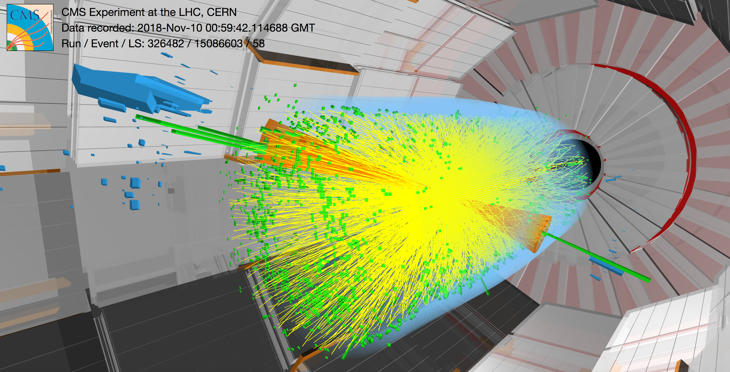

Deep Neural Networks applications in experimental physics data analysis
Systematic study of the importance of each of the low-level taggers used in ATLAS for b-jet tagging in Pb+Pb collisions using a deep neural network
Afonso Azenha
Supervisor: Prof. Helena Santos (LIP and FCUL)

Slide 2

Index
Motivation:
The quark-gluon plasma;
Jets and b-jets;
b-jets and b-tagging.
How to tag b-jets:
Low-level taggers (LLTs);
High-level taggers – DL1.
Results:
Example - All LLTs case;
Comparison - ROC curves.
Conclusions.
ATLAS under maintenance during LS2.

Slide 3
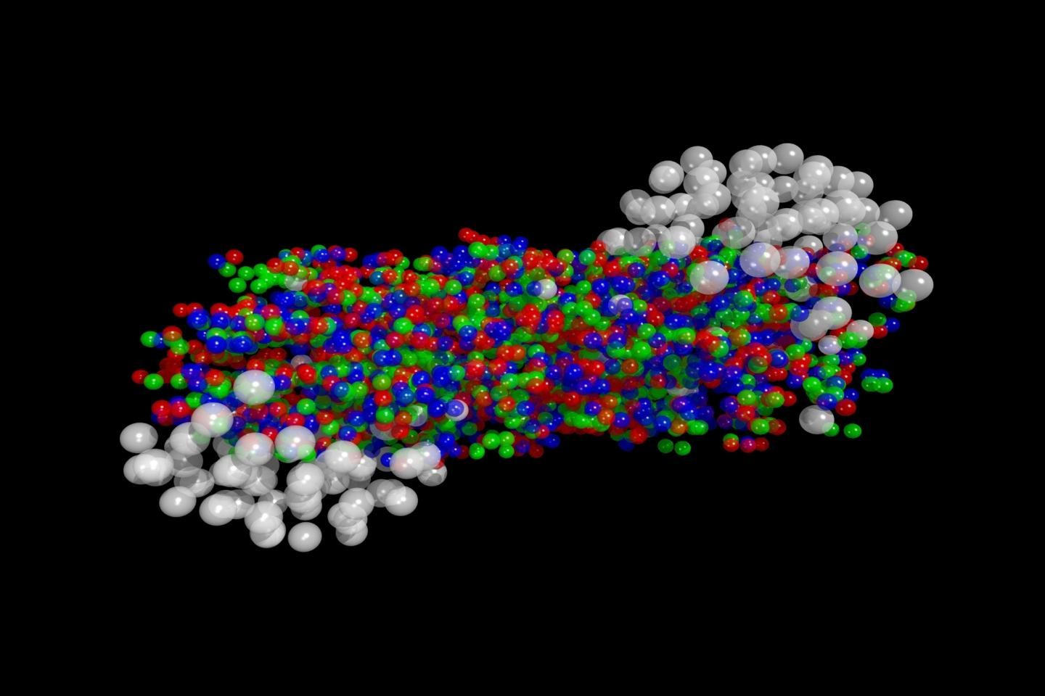
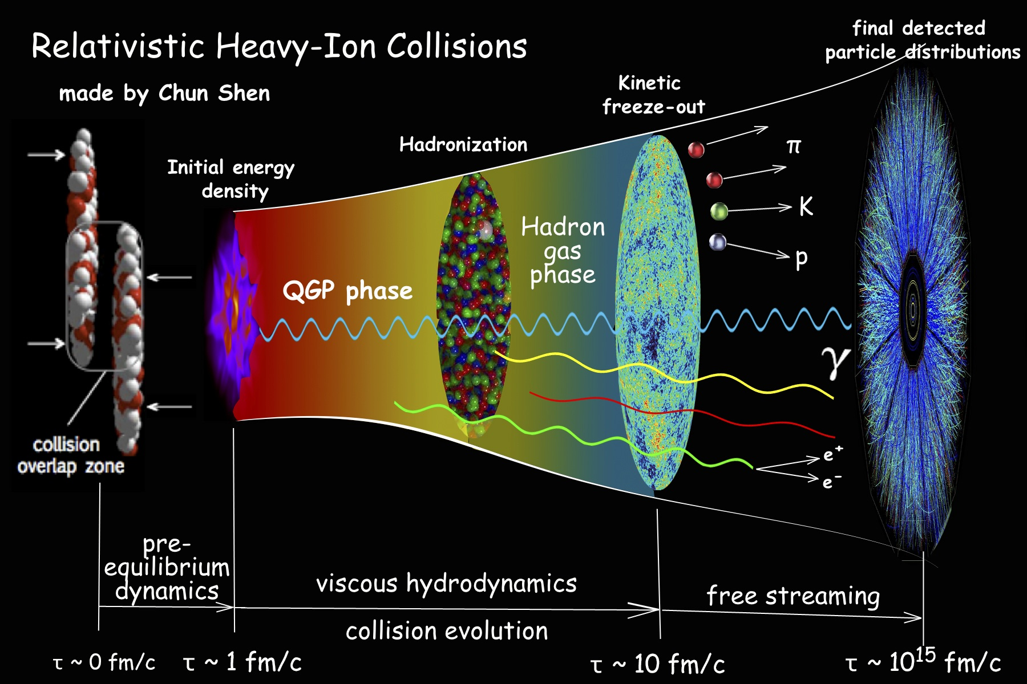

Motivation: The quark-gluon-plasma
QGP illustration.
The quark-gluon plasma is a ”state of matter” in which the elementary particles that make up the hadrons of baryonic matter are freed of their strong attraction for one another under extremely high energy densities.
Existed in the Universe a tiny fraction of time after the Big Bang (10⁻¹² to 10⁻⁶ seconds after).
Fundamental to understand how the Universe was created!
Relativistic HI collision schematic.

Slide 4
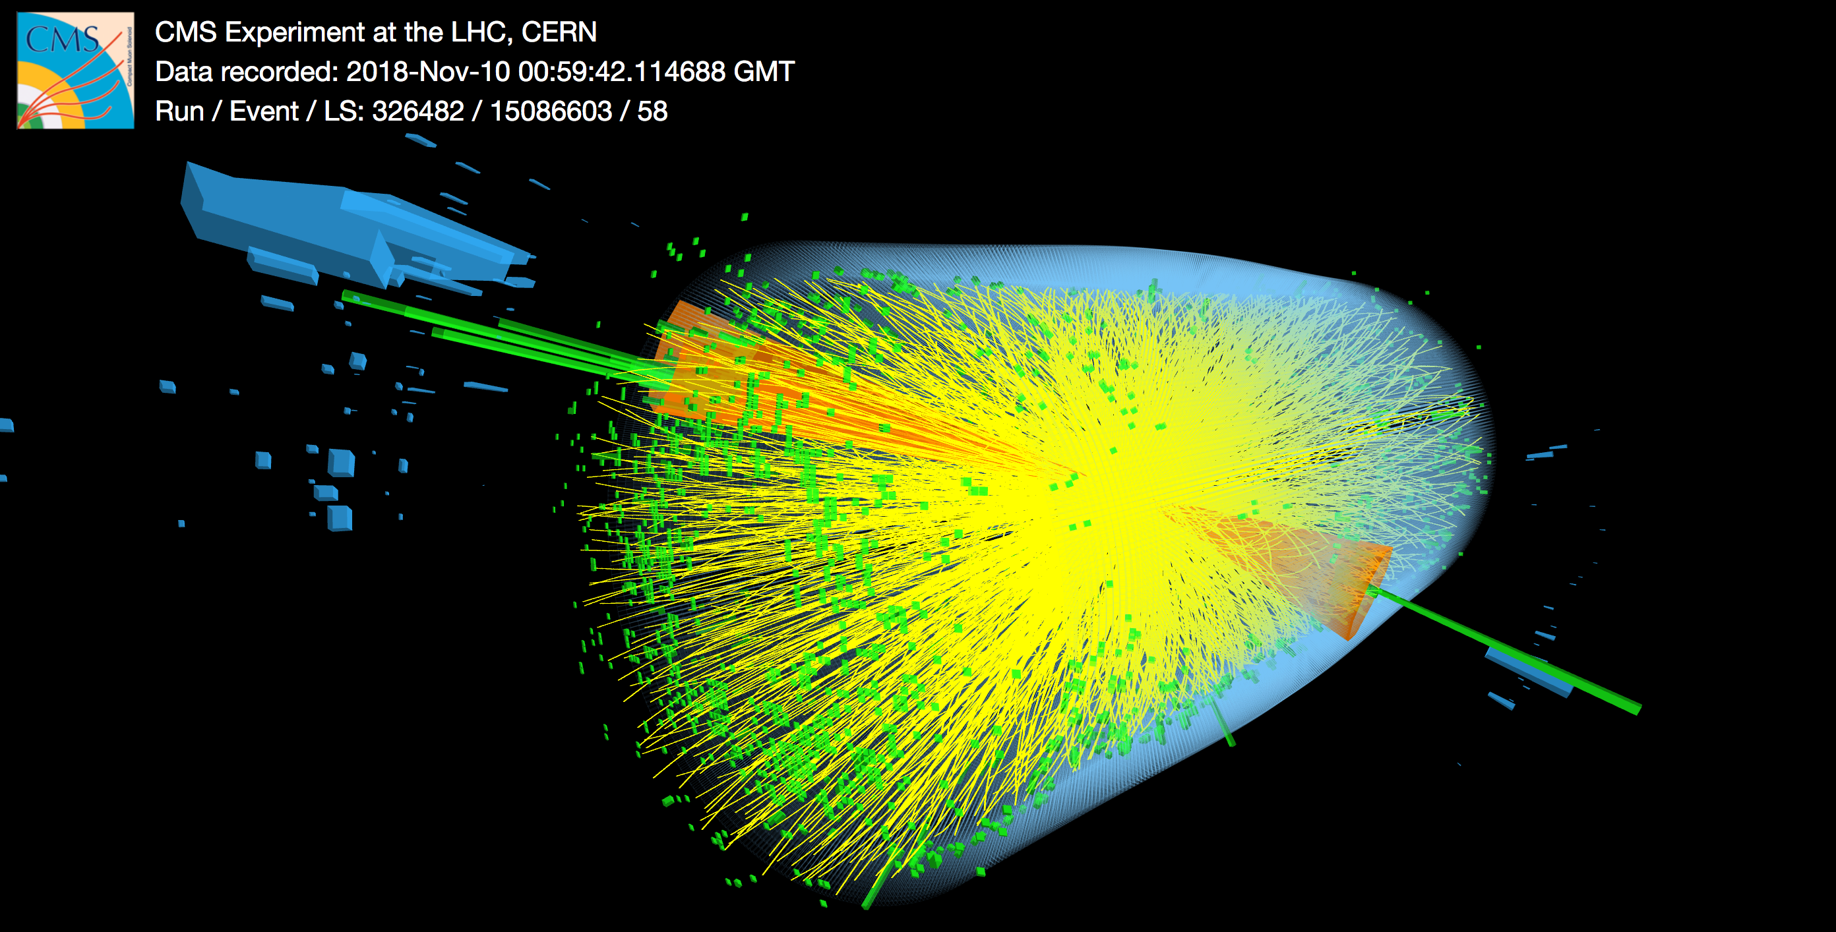
Motivation: Jets and b-jets
Jets: collimated sprays of particles originating from the hadronization of quarks;
They come in 3 flavours:
b-jets;
c-jets;
light-jets.
Jets serve as probes!

Slide 5
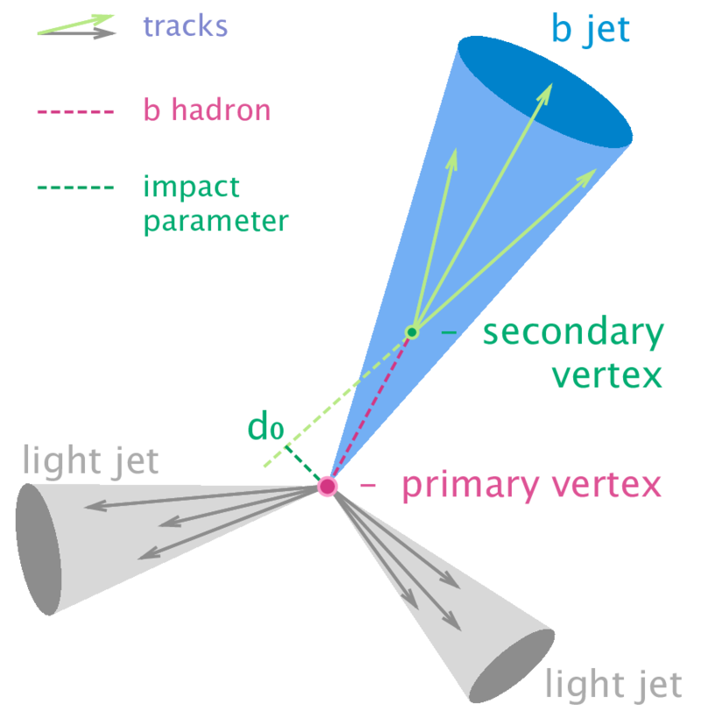
Motivation: b-jets and b-tagging
b-tagging is utilized to study physics processes with b-jets in their final state:
Standard Model Higgs sectors (H → bb, HH → bbbb, ...);
Top physics (t → W b);
Beyond Standard Model searches (X → bY).
b-hadrons:
Sufficient lifetime → they travel some measurable distance before decaying → displaced secondary vertex;
High mass (few GeV) → decay products with a larger p_{T} (transverse momentum), which means b-jets:
Are wider;
Have higher multiplicities (numbers of constituent particles) and invariant masses;
Diagram illustrating the
structure of a b-jet.

Slide 6
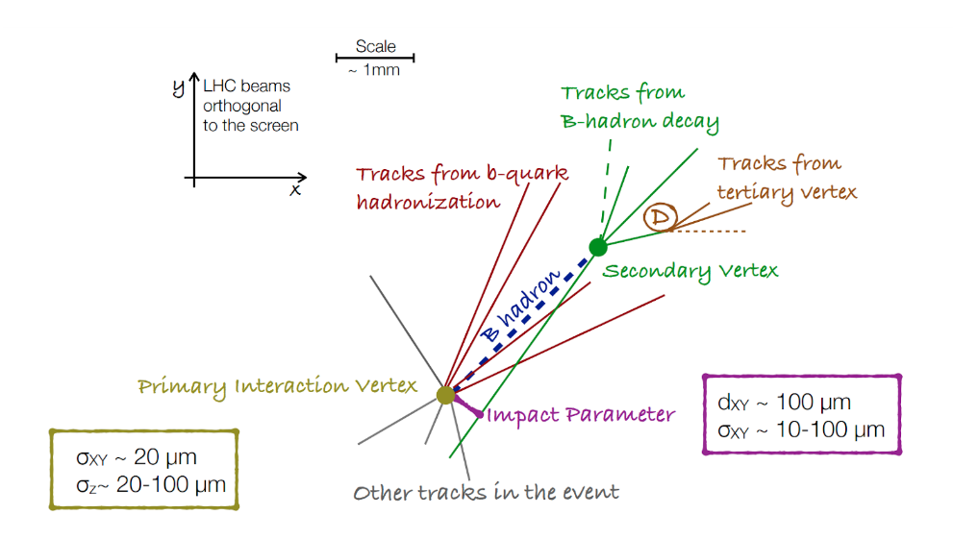
How to tag b-jets: Low-level taggers (LLTs)
Exploit the jet’s properties to infer its flavour.
3 types:
Algorithms based on impact parameters: IP2D and IP3D;
Secondary vertex finding algorithms: SV1;
Topological multi-vertex finding algorithms: JetFitter.
Diagram illustrating the
structure of jets formed in a collision.

Slide 7
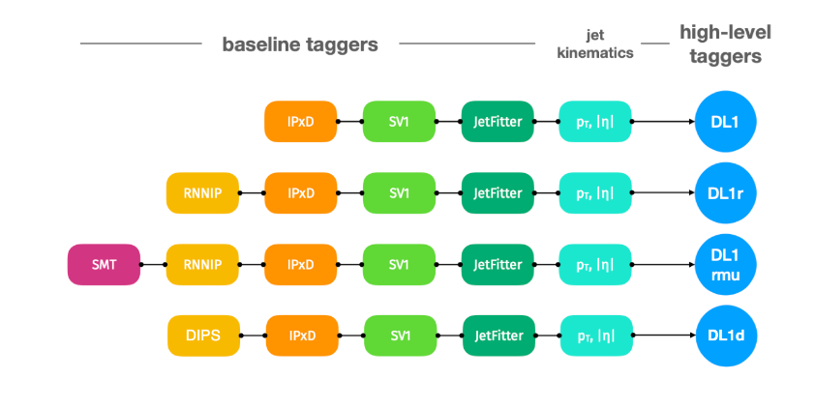
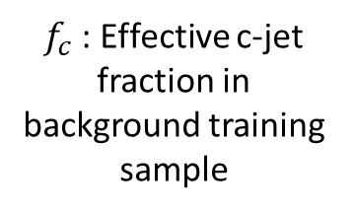
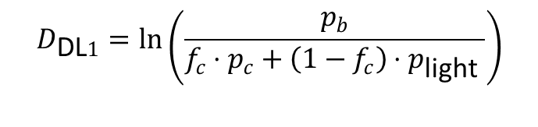
How to tag b-jets: High-level taggers – DL1
$f_{c}$: Effective c-jet fraction in background training sample
p_{b}
p_{c}
p_{light}
For b-tagging:
$$D_{\text{DL}1}=\ln\left(\frac{p_{b}}{f_{c}⋅p_{c}+\left(1−f_{c}\right)⋅p_{\text{light} }}\right)$$
DL1 base
Different DL1 variants
DL1 discriminant

Slide 8
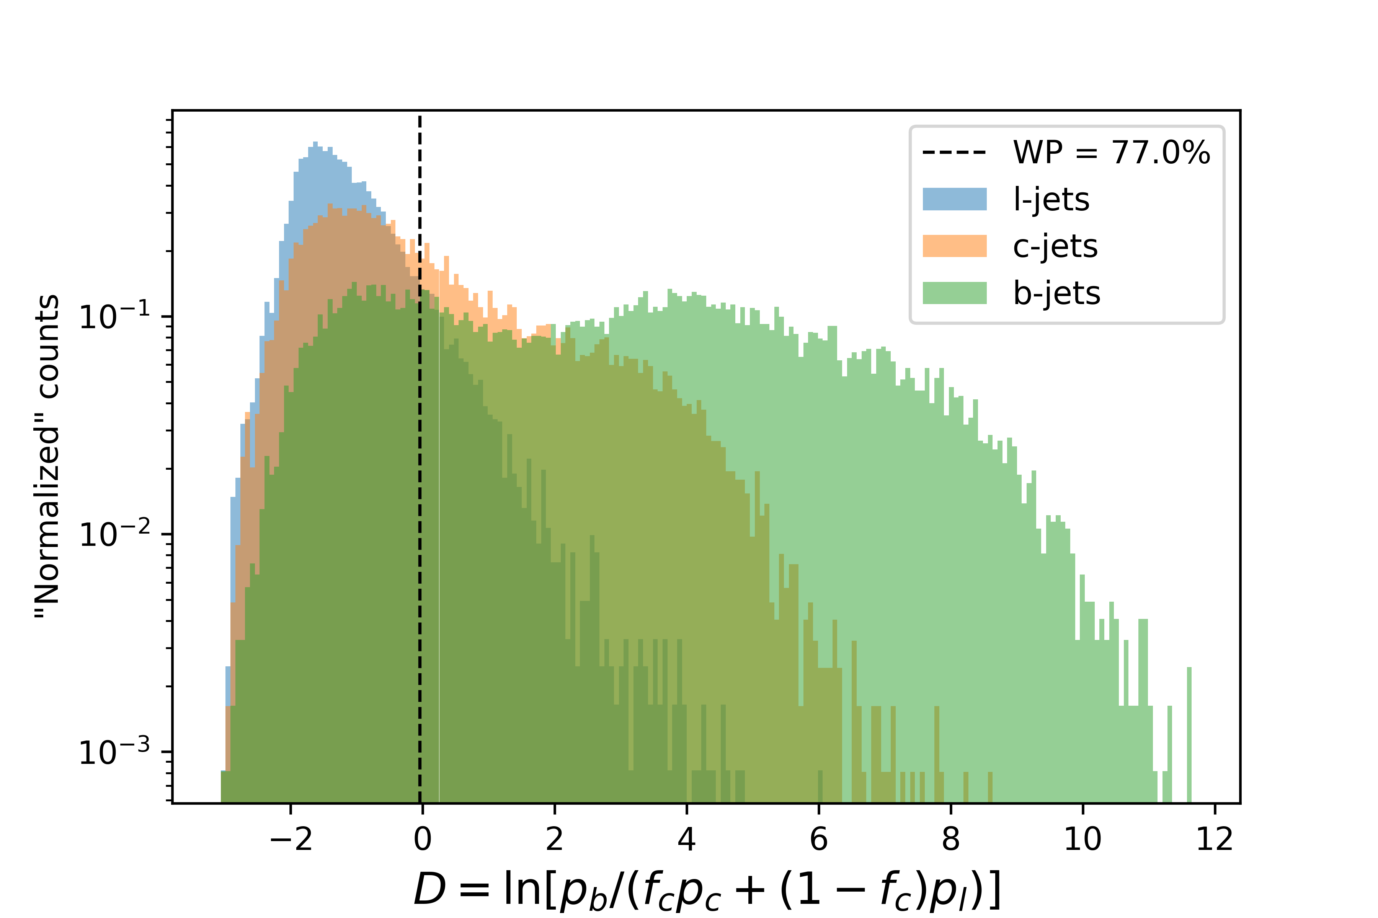
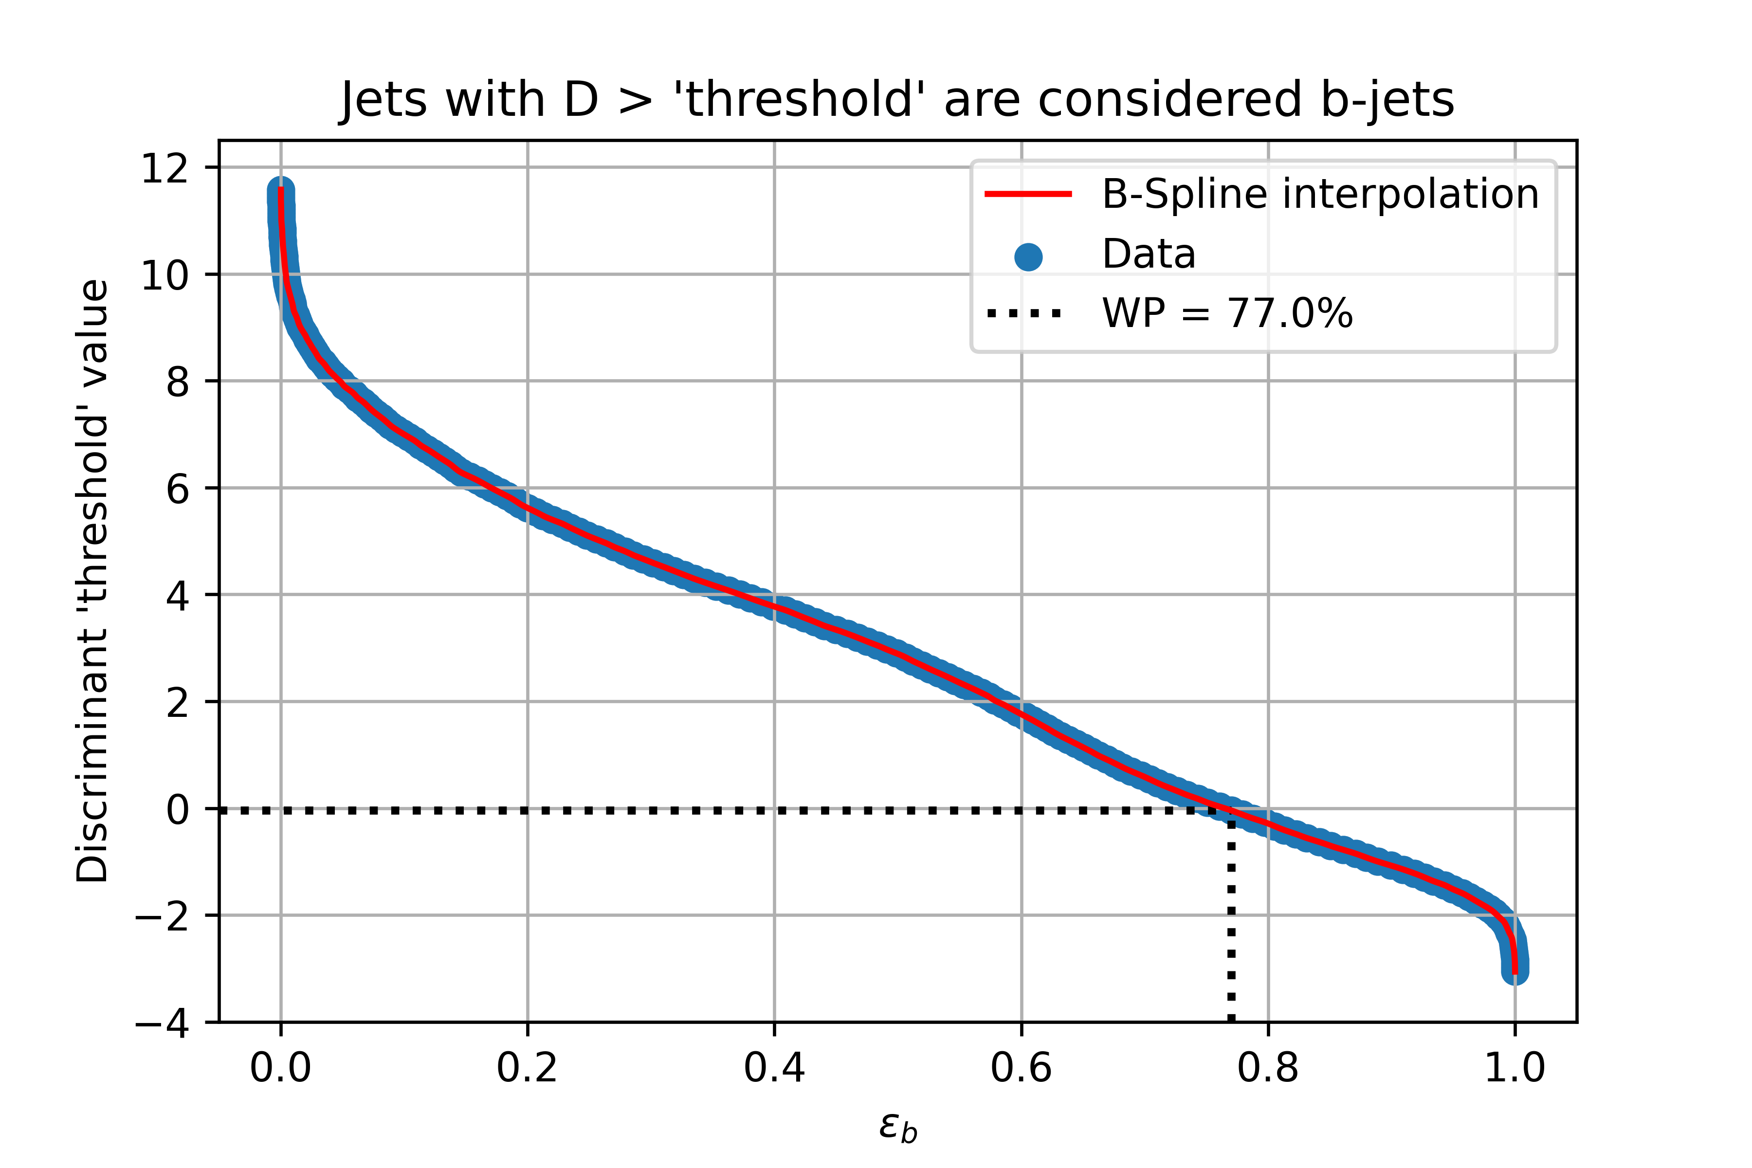
Results: Example - All LLTs case
Number of jets’ distribution in the discriminant values.
Discriminant ‘threshold’ value as a function of ε_{b}.

Slide 9
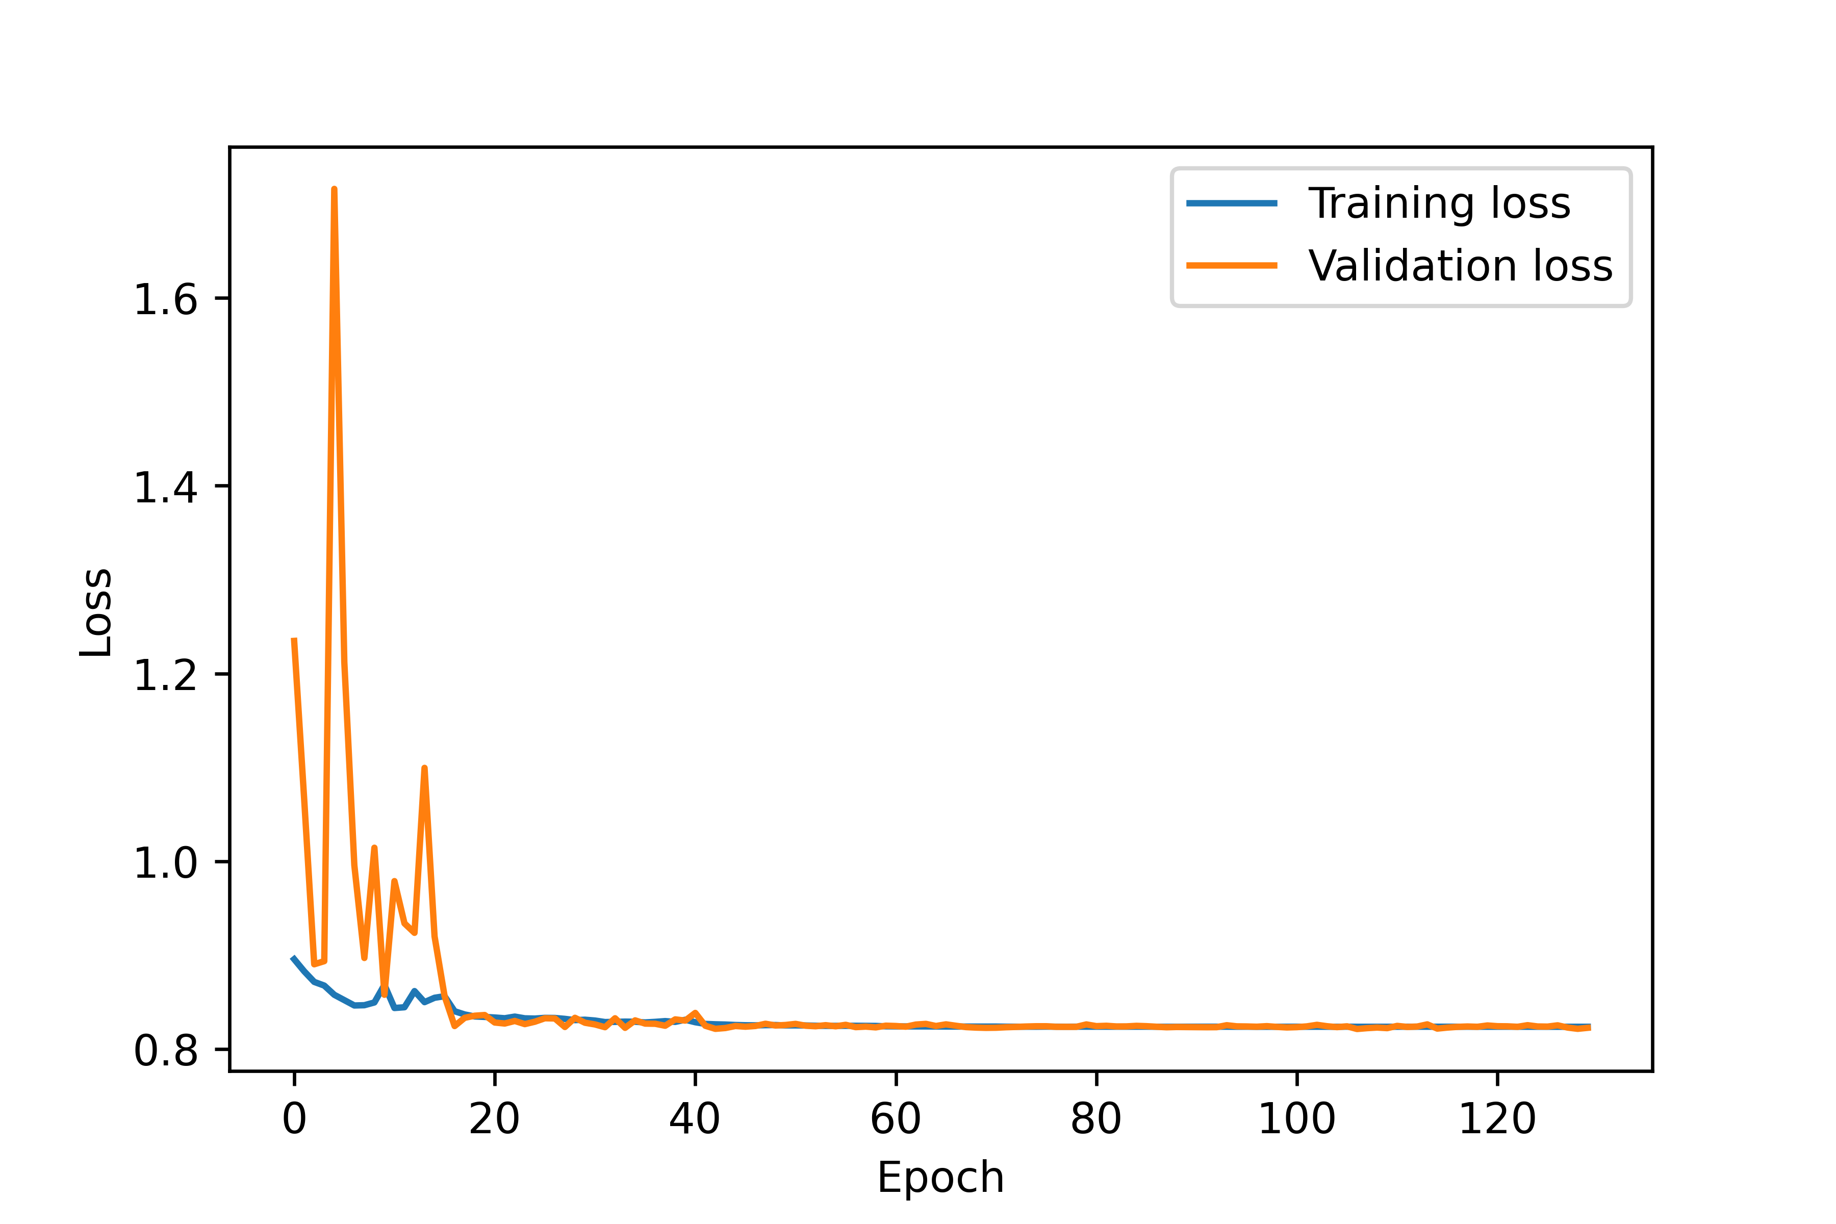
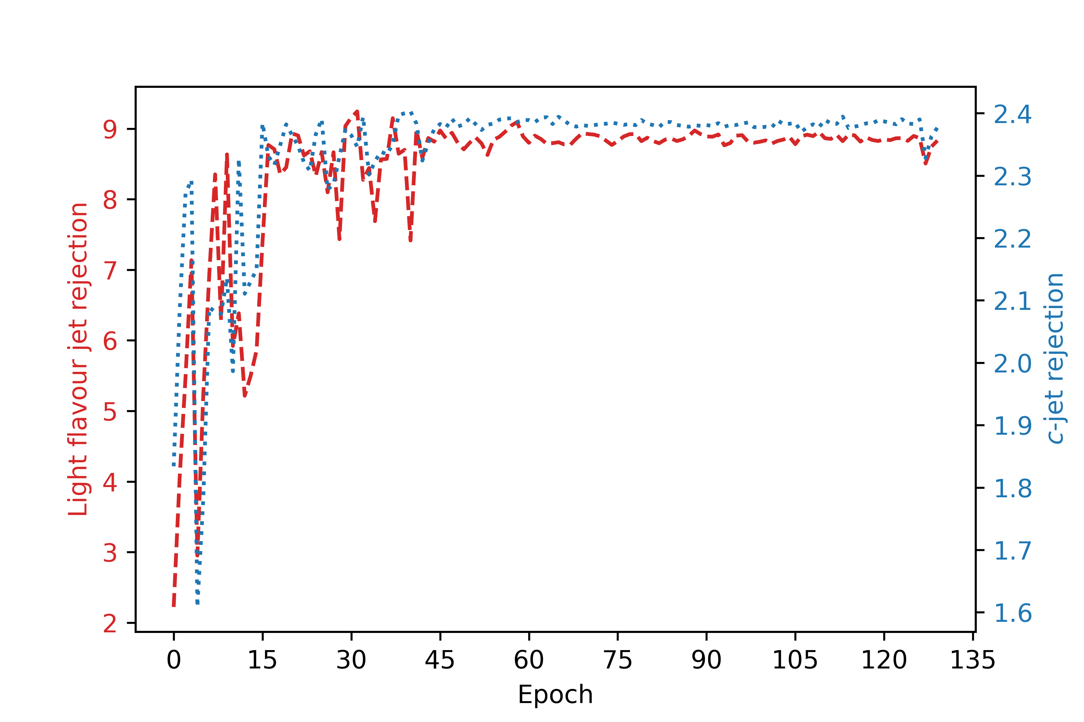
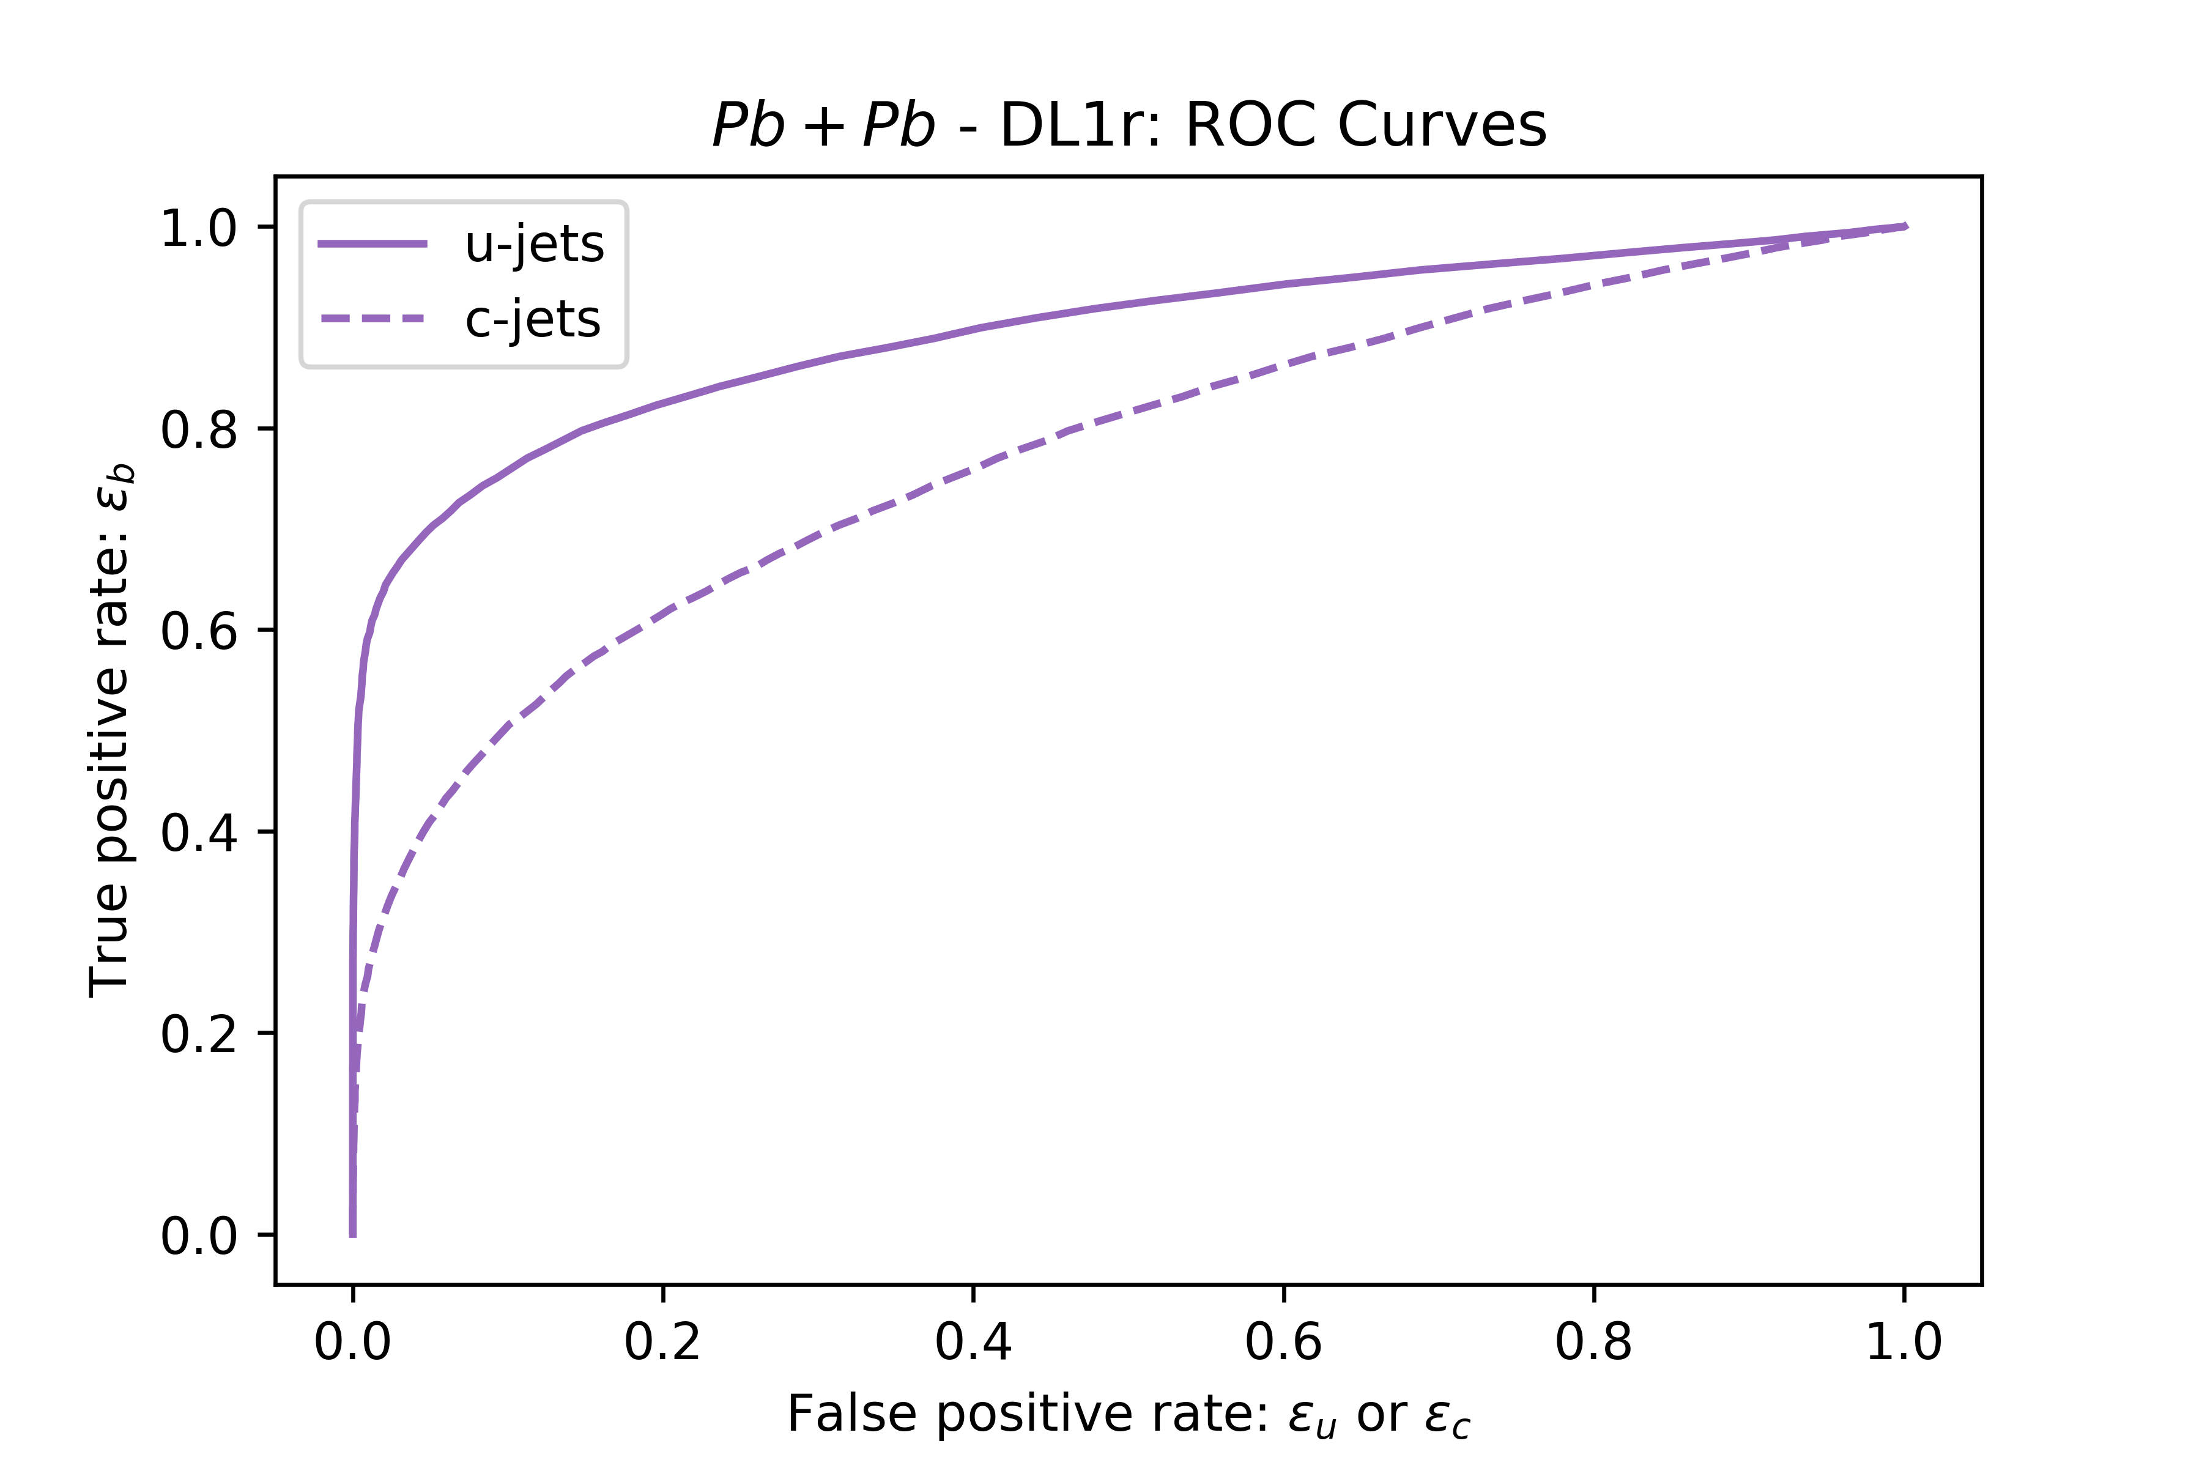
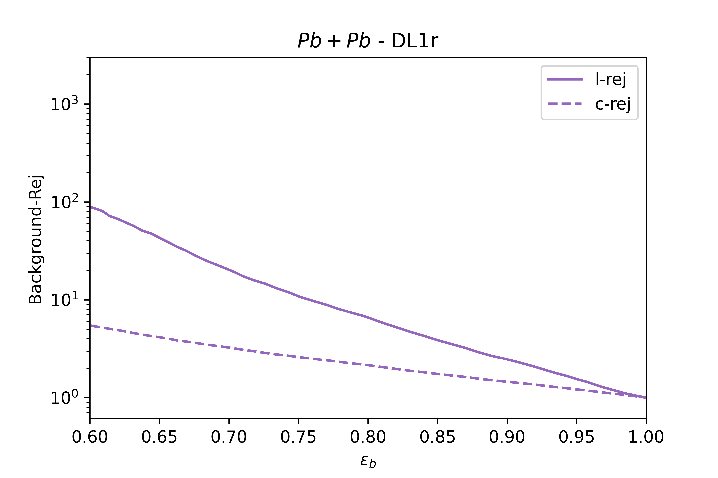
Results: Example - All LLTs case (cont.)
Losses per epoch
Rejections per epoch
:
(ATLAS)

Slide 10
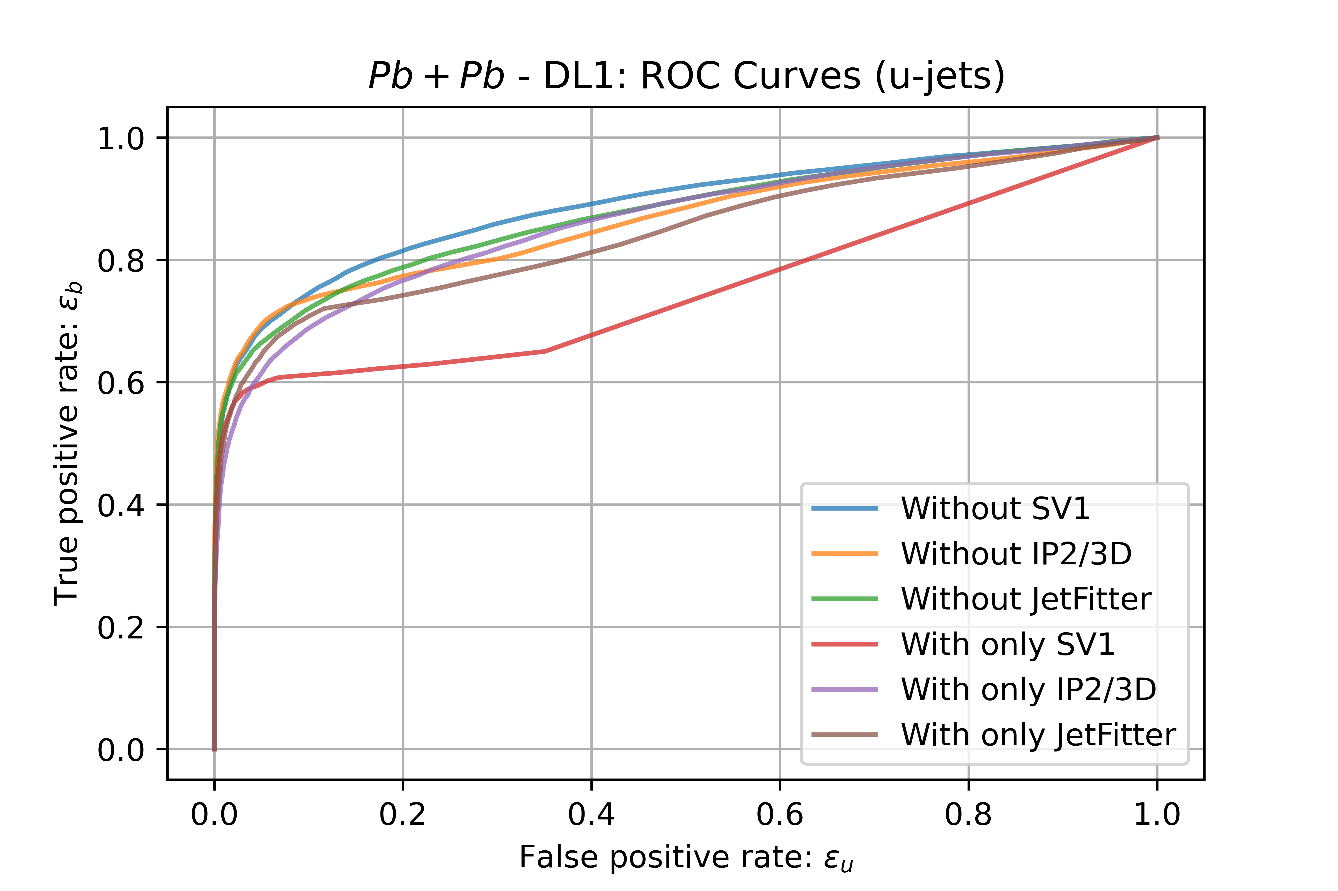
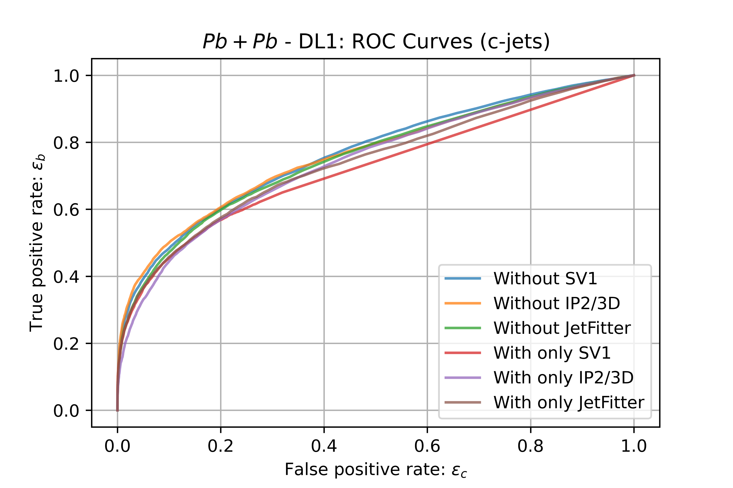
Results : Comparison - ROC curves
ROC curves for u-jets: Most* combinations.
ROC curves for u-jets: Most* combinations.
*We’re missing ‘All LLTs’ and ‘No LLTs’.

Slide 11
Results : Comparison - ROC curves
Results for light-jets
 | AUC
 | For u-jets | For c-jets
IP2(3)D Only | 0.8617 | 0.7718
JetFitter Only | 0.8432 | 0.7401
SV1 Only | 0.7514 | 0.7202
Without IP2(3)D | 0.8643 | 0.7625
Without JetFitter | 0.8731 | 0.7559
Without SV1 | 0.8876 | 0.7659
With all LLTs | 0.8911 | 0.7712
With no LLTs | 0.5008 | 0.4961
Table: Area Under the Curve (AUC) values.

Slide 12

Results : Comparison - ROC curves
Results for c-jets
 | AUC
 | For u-jets | For c-jets
IP2(3)D Only | 0.8617 | 0.7718
JetFitter Only | 0.8432 | 0.7401
SV1 Only | 0.7514 | 0.7202
Without IP2(3)D | 0.8643 | 0.7625
Without JetFitter | 0.8731 | 0.7559
Without SV1 | 0.8876 | 0.7659
With all LLTs | 0.8911 | 0.7712
With no LLTs | 0.5008 | 0.4961
Table: Area Under the Curve (AUC) values.

Slide 13
Conclusions
This work allows for a deeper comprehension of the LLTs influence in b-tagging when working with a deep neural network. This is useful for deciding which input parameters we want to choose for DL1.

Slide 14
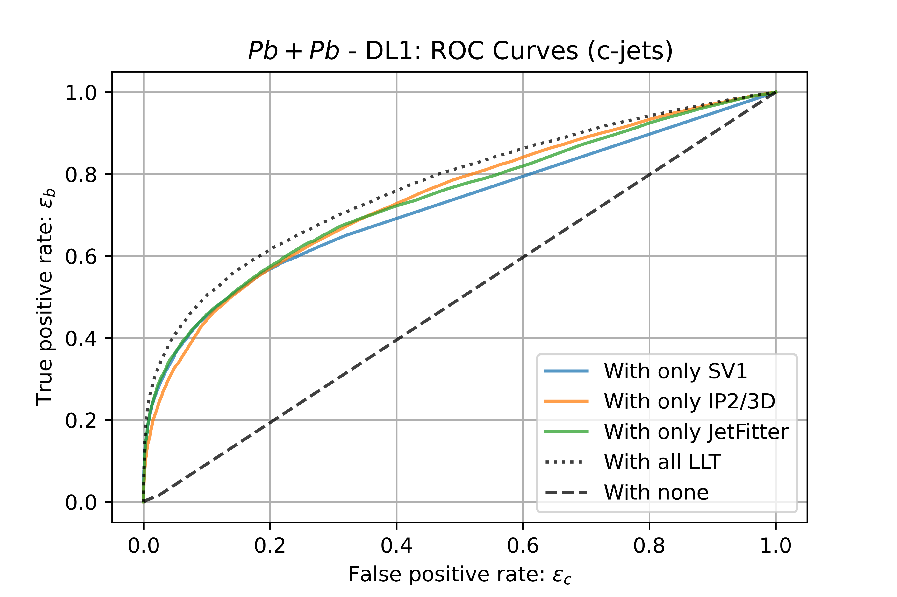
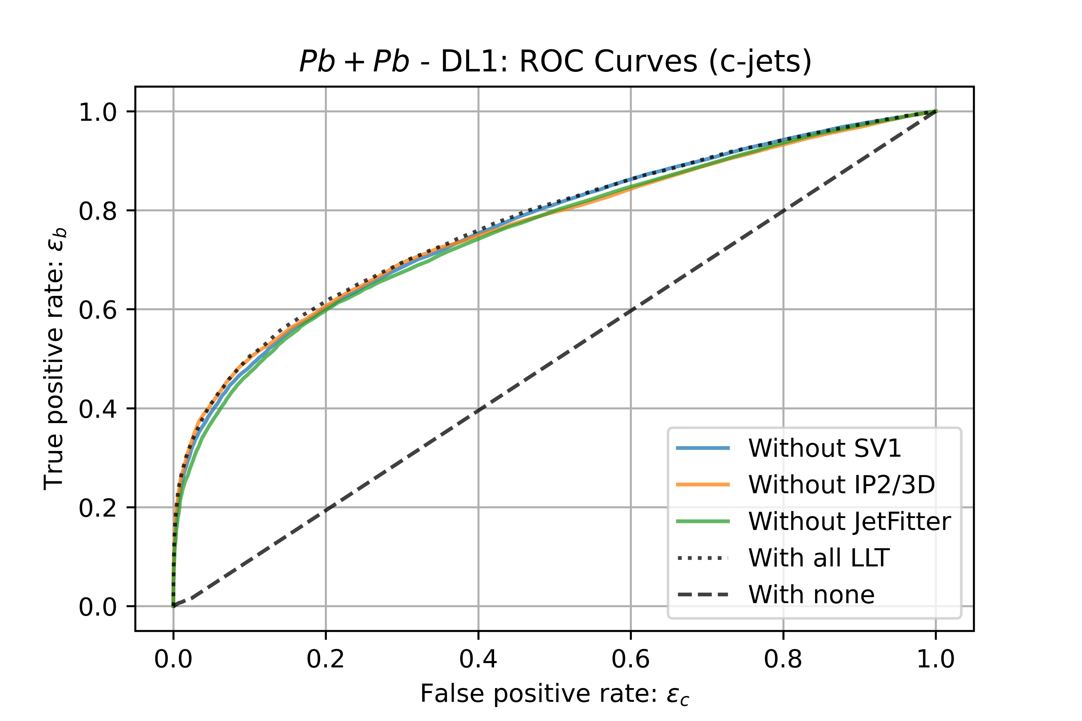
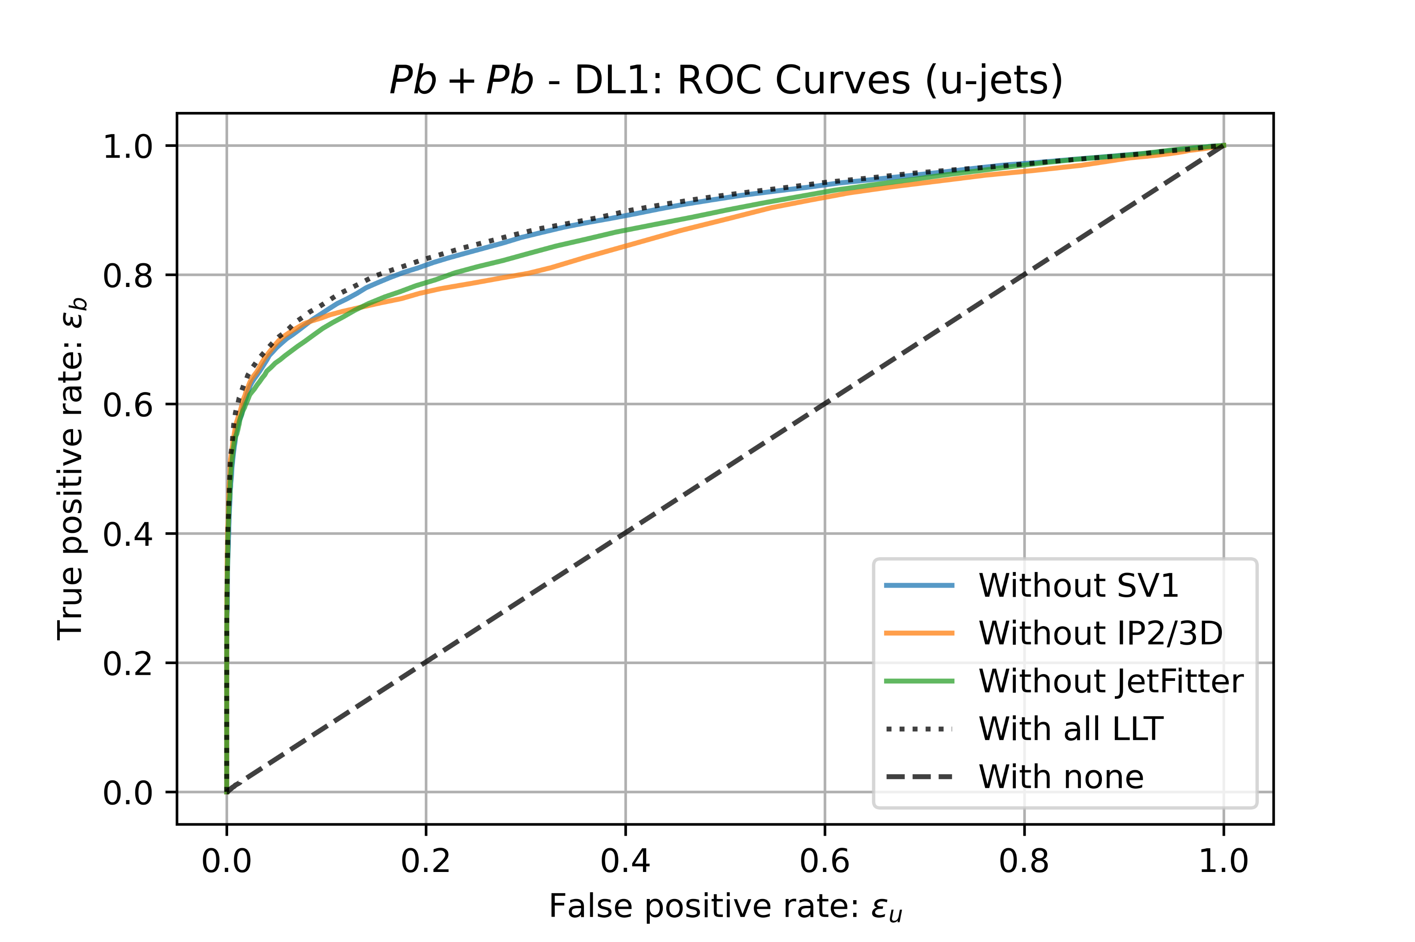
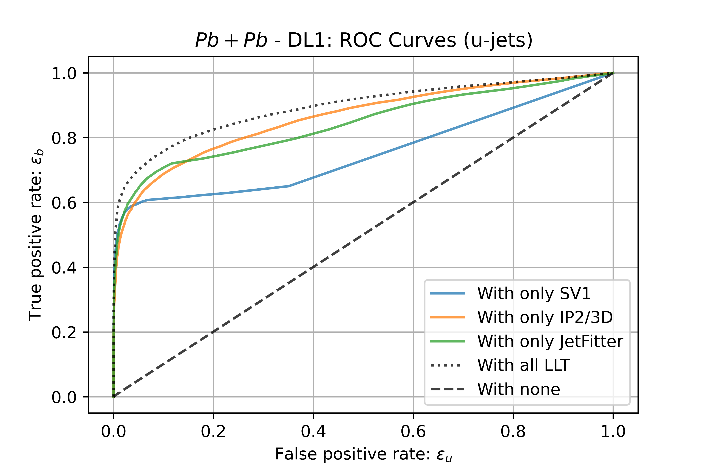
Back-up slides: More ROC curves

Slide 15
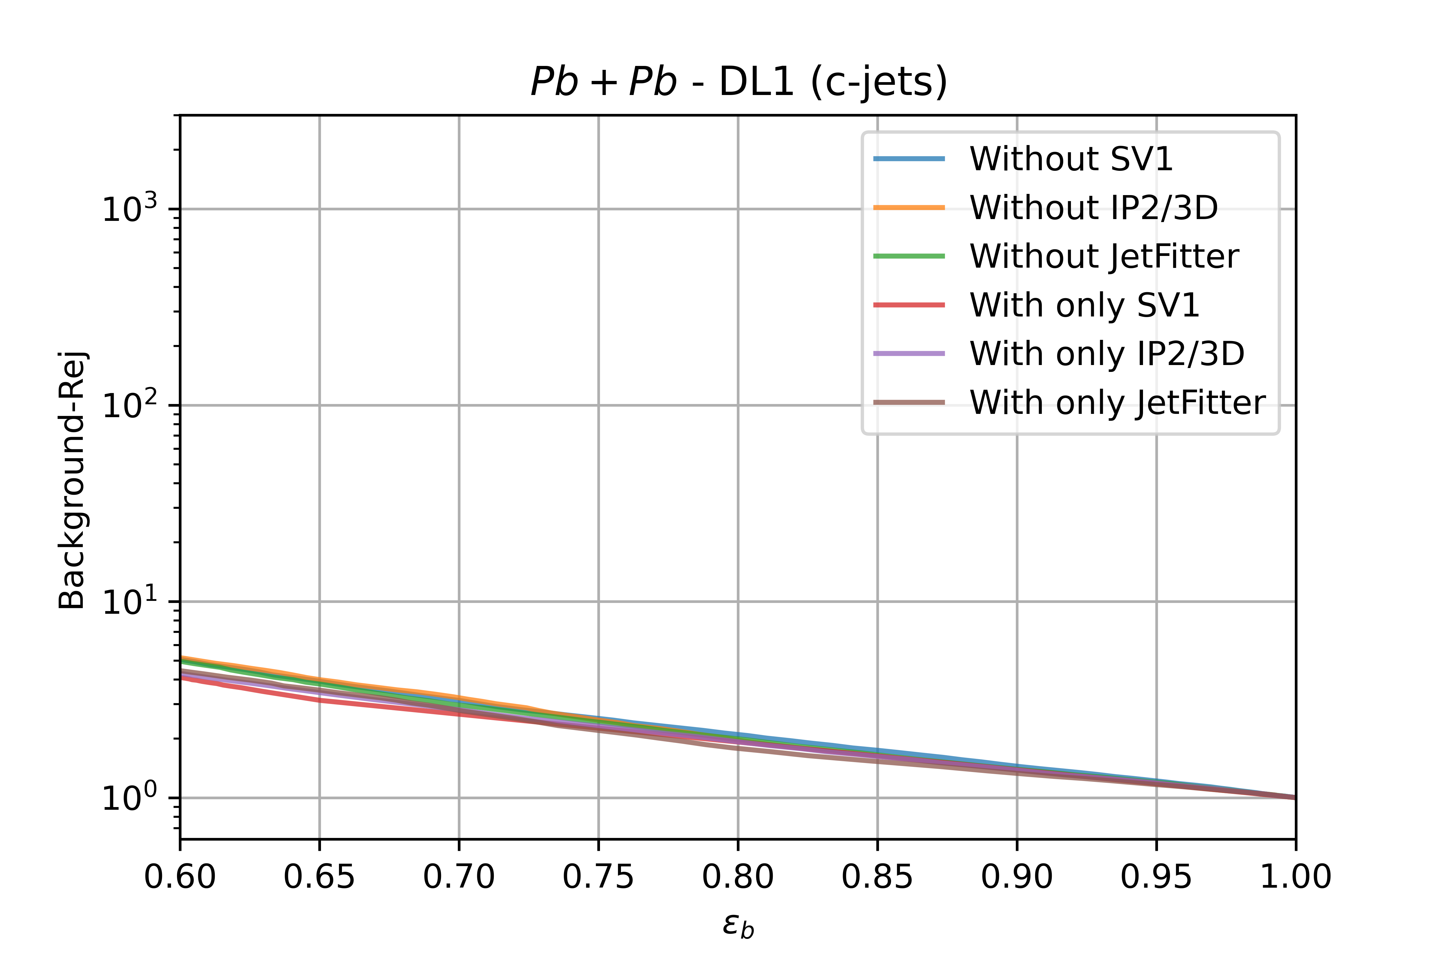
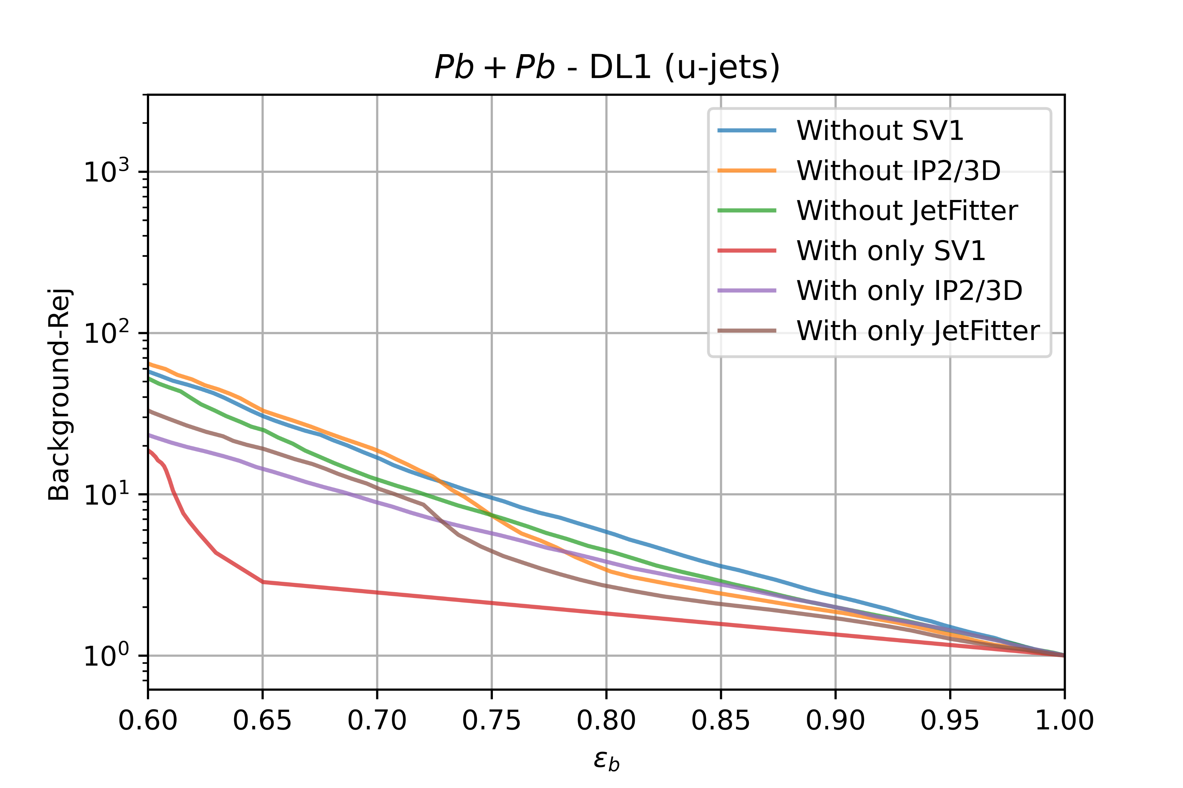
Results: ROC curves (ATLAS convention)

Slide 16
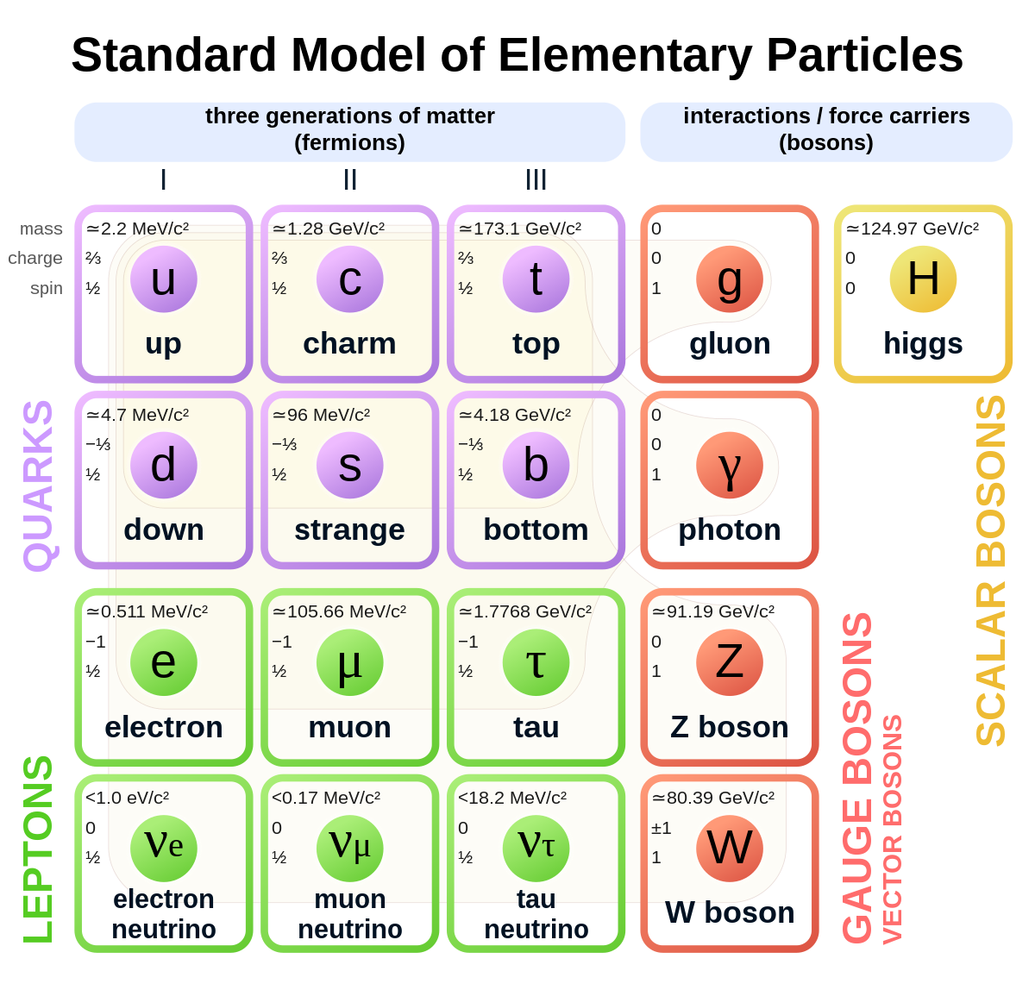
The Standard Model
Elementary particles of the Standard Model.

Slide 17
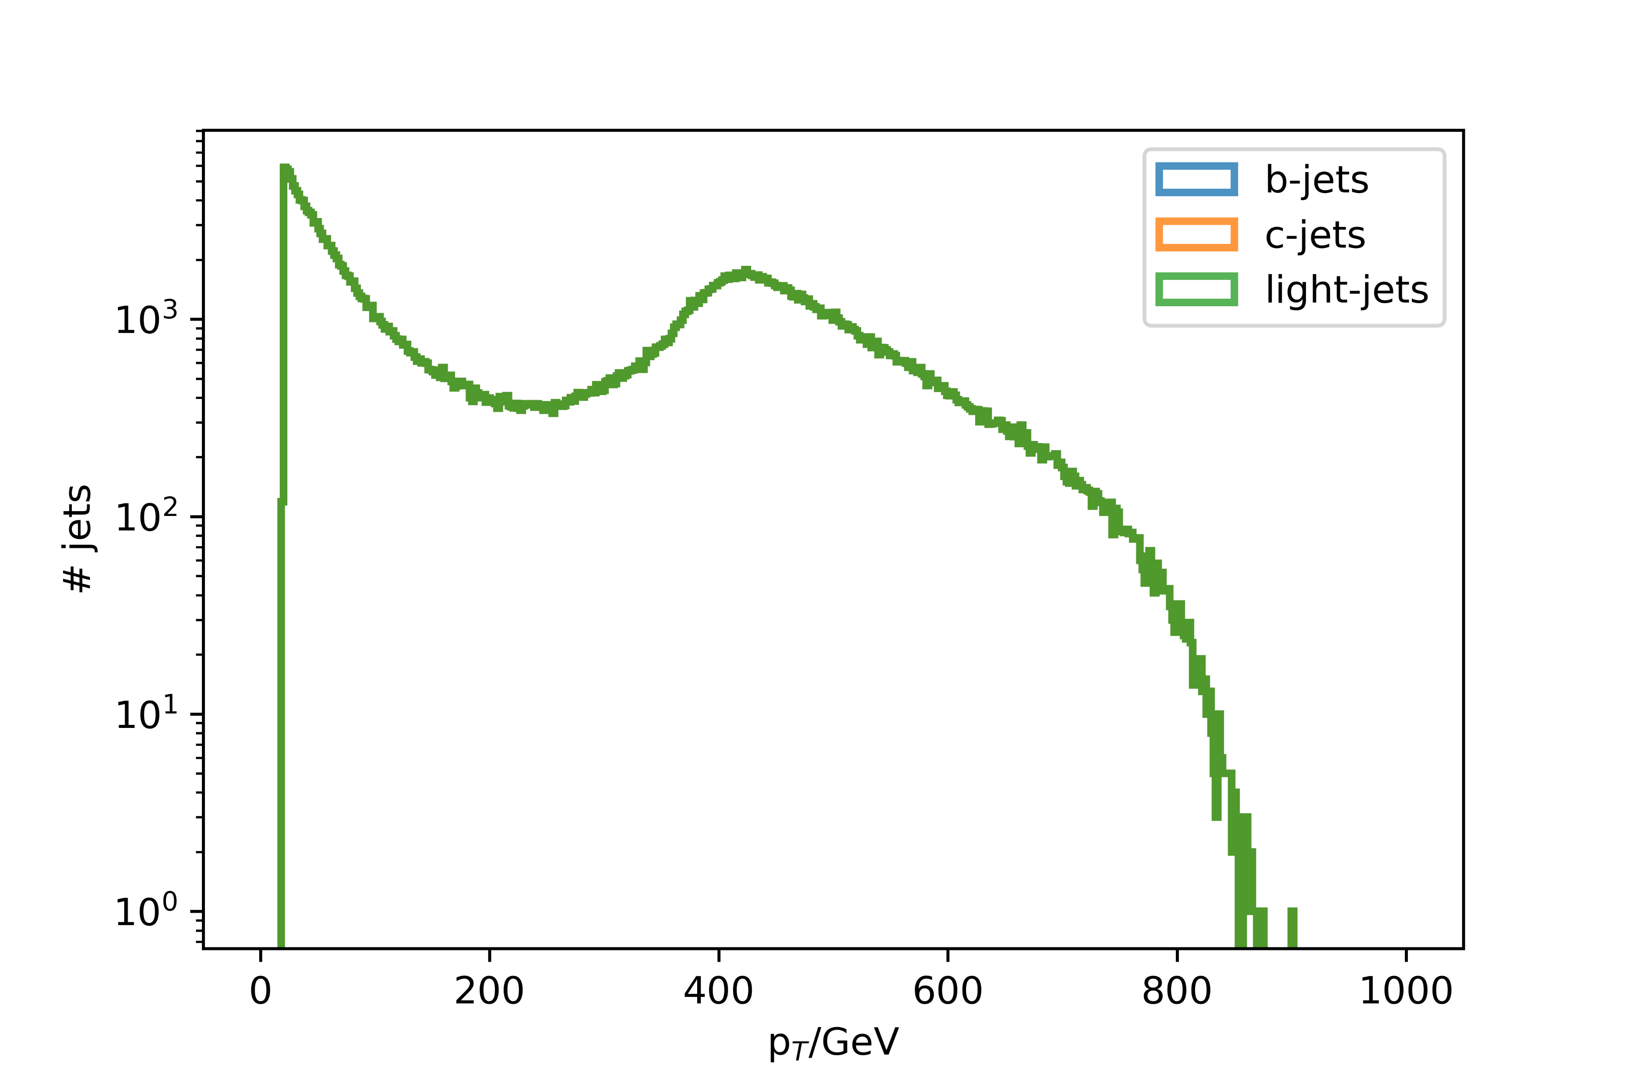
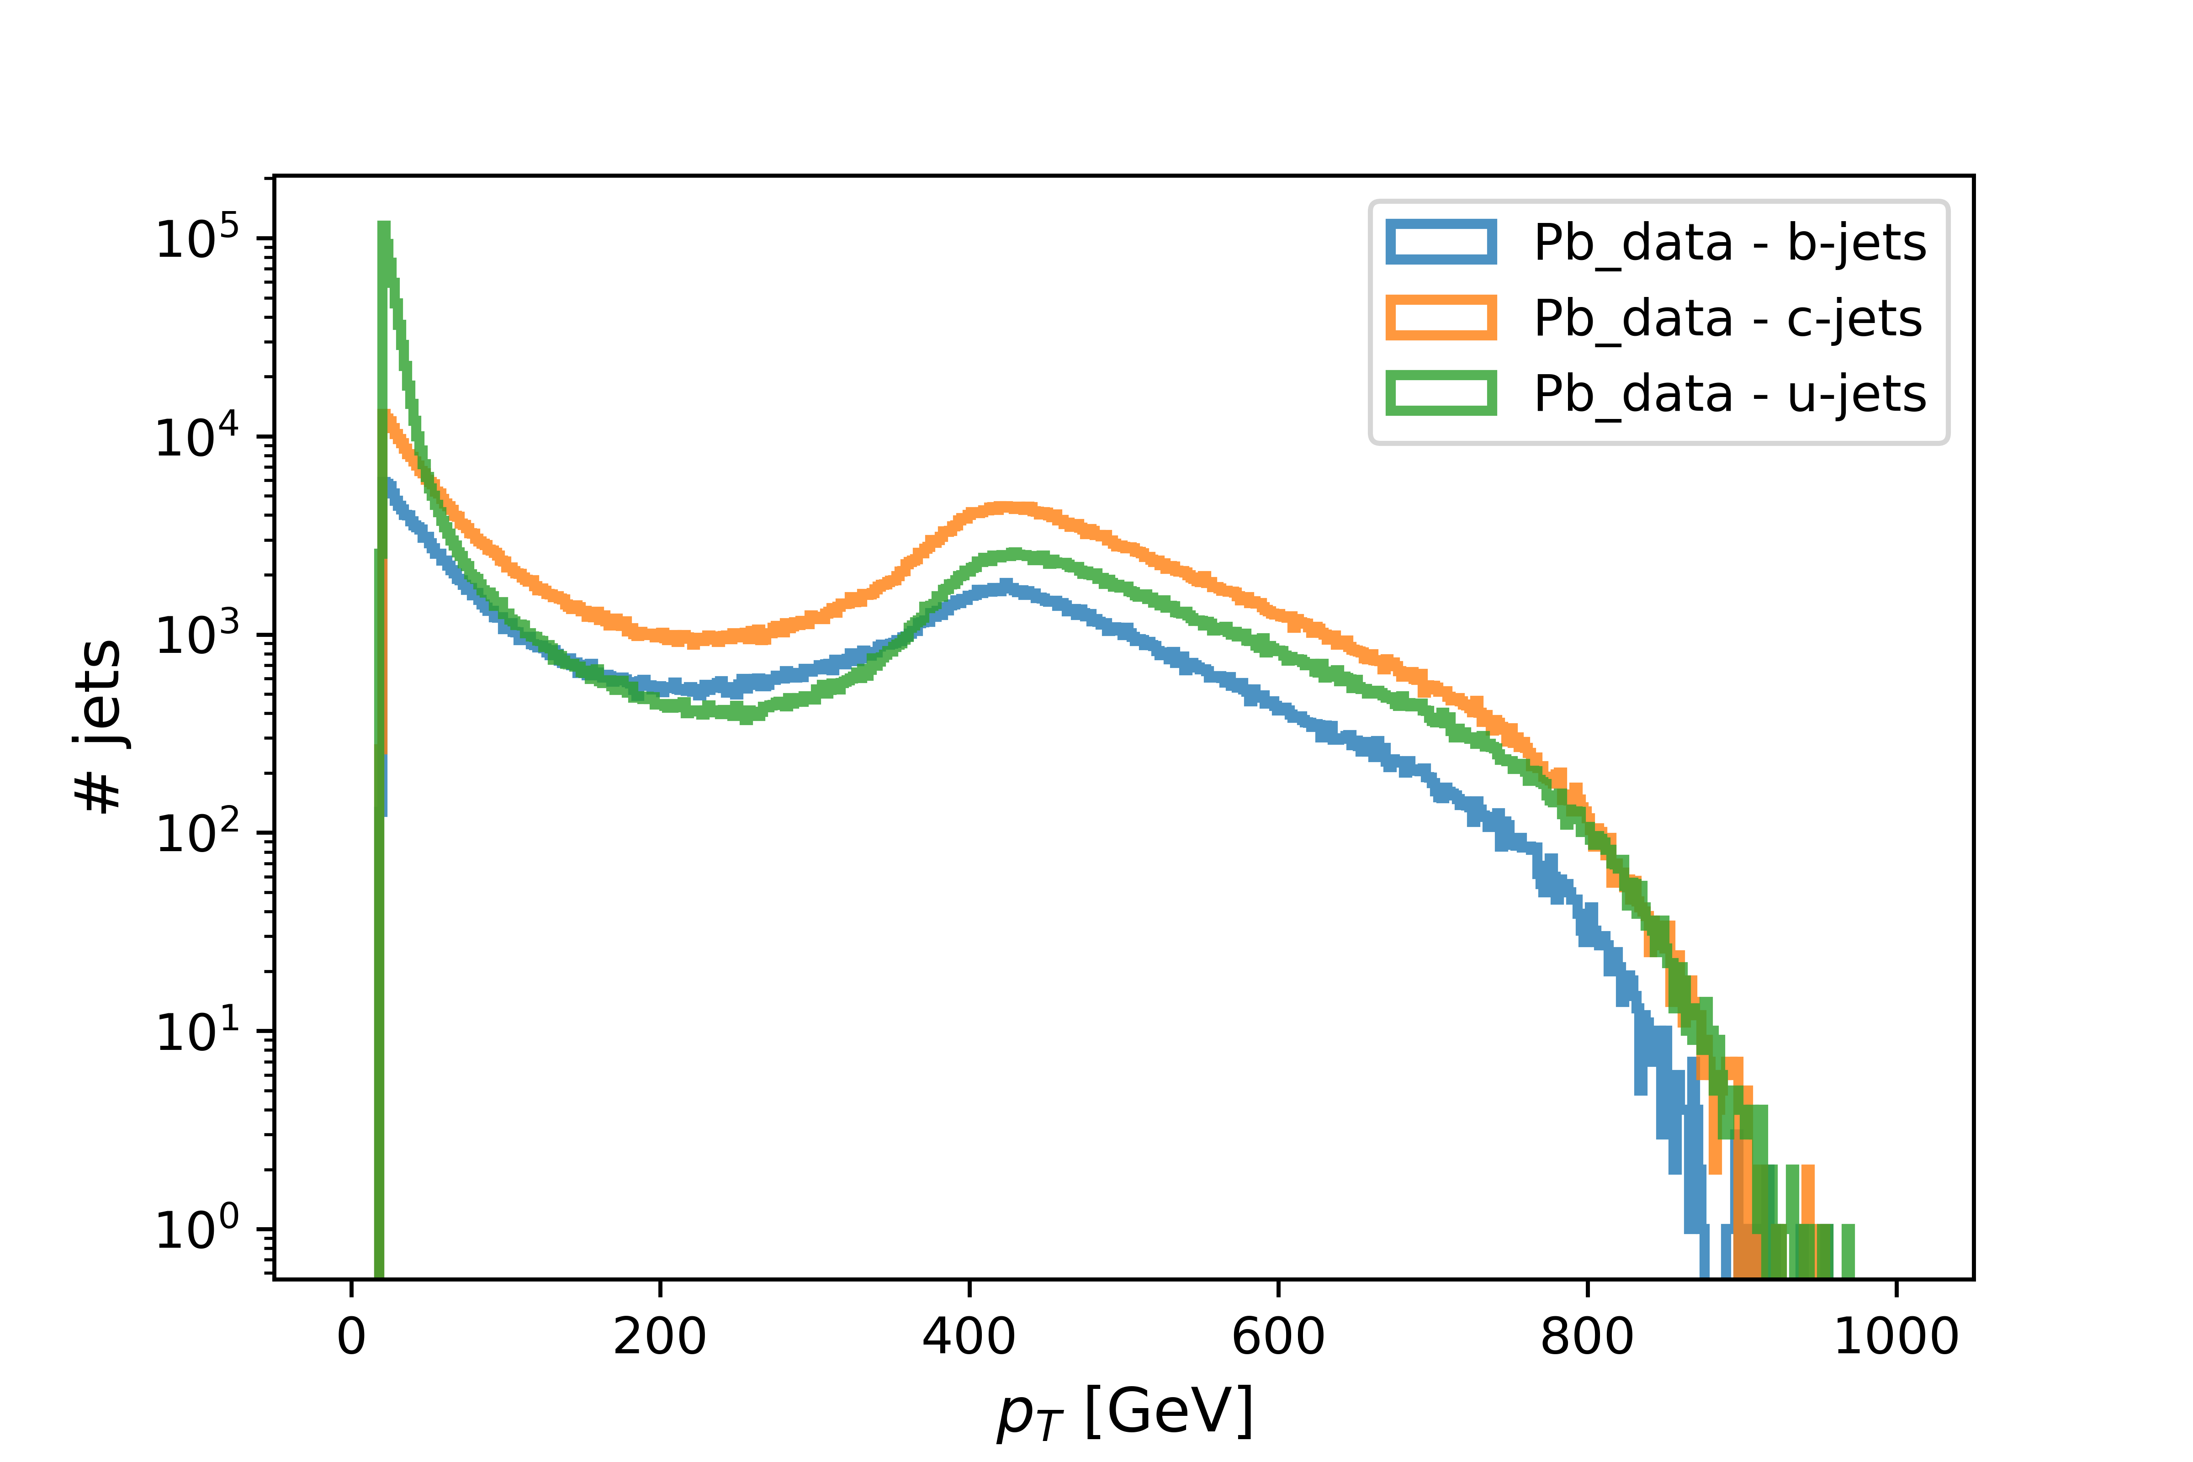
p_{T} distributions
p_{T} distributions after down-sampling.
p_{T} distributions before down-sampling.

Slide 18
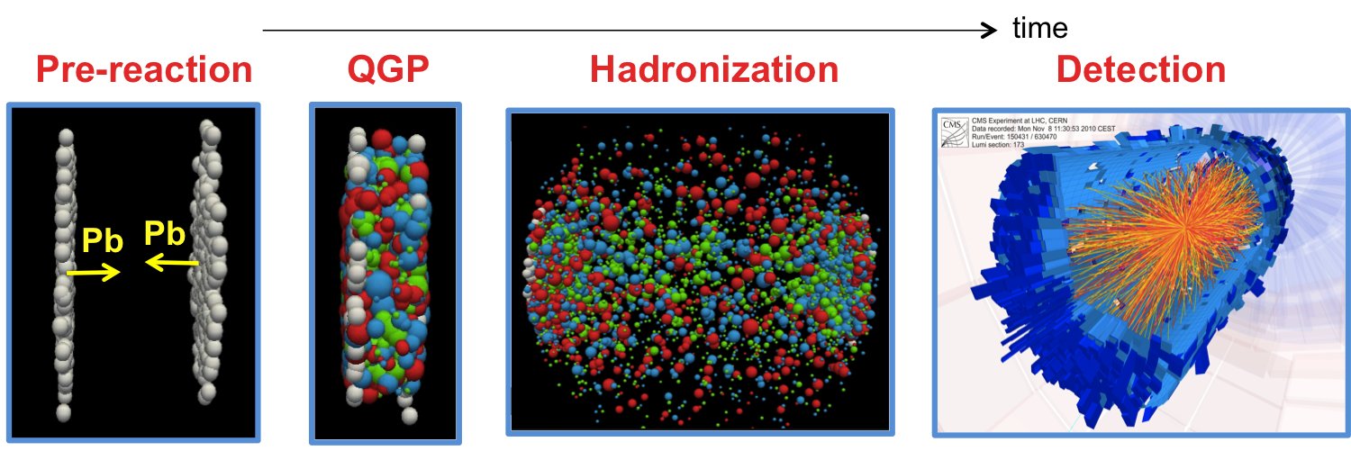
QGP Formation

Slide 19
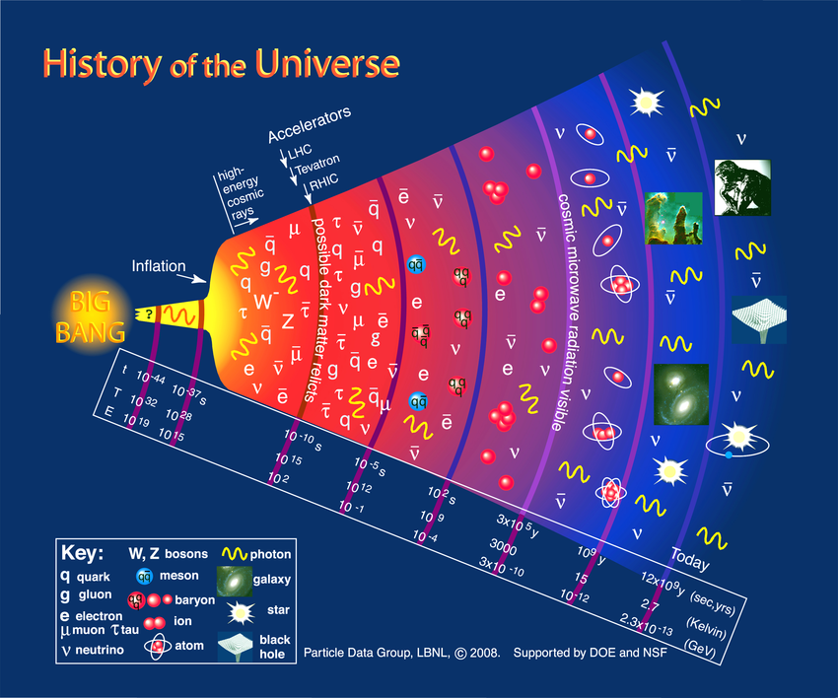
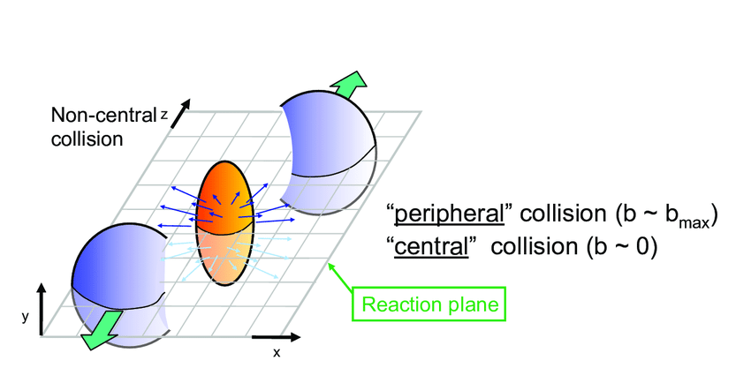
QGP Formation
QGP

